Slide 1

Graph-powered Machine Learning for Movie Predictions
Nathan Smith
Kansas City Graph Databases Meetup
December 6, 2022

Slide 2
Nice to meet you
Senior Data Scientist for Neo4j Professional Services since 2021
Data scientist for six years, data professional for fifteen
Doctor of Musical Arts in piano from UMKC
Was never very good at basketball

Slide 3
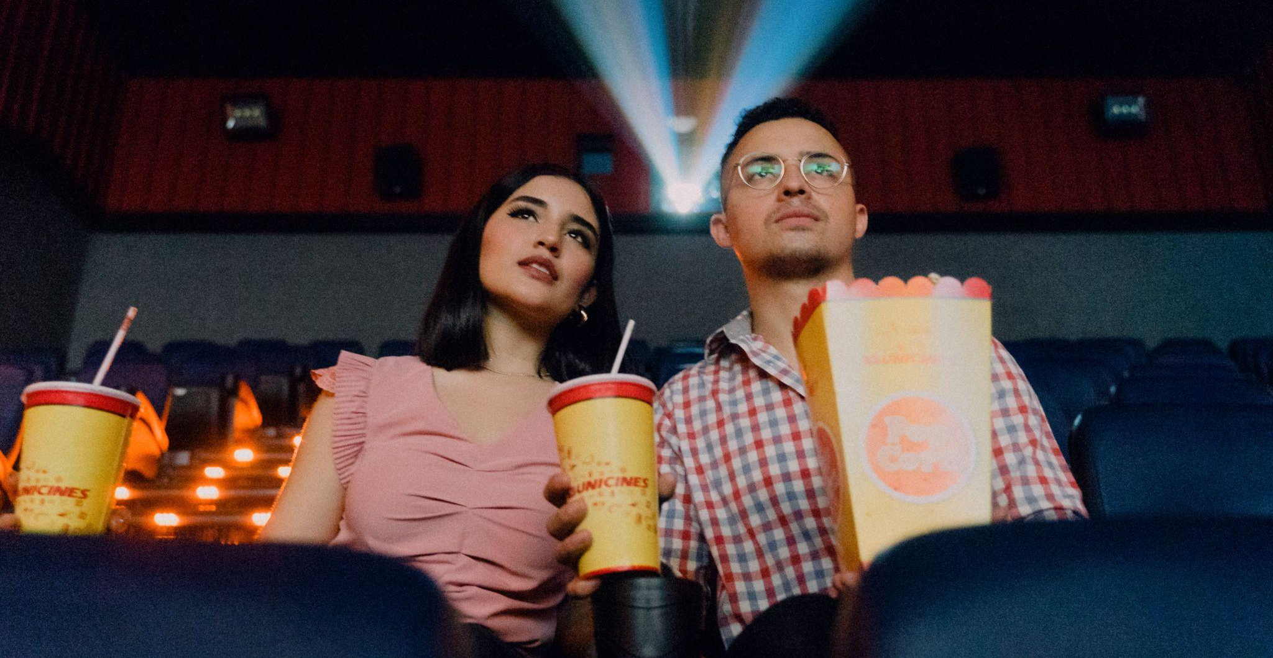
Will this movie be profitable?

Slide 4
Graph embeddings
Model the domain as a network graph
Represent the nodes as low-dimensional vectors
Use the embedding vectors as features for machine learning
Expressive, intuitive data model captures real-world nuances and context
Nodes near each other in the graph end up near each other in the embedding space
Use embeddings alone or in combination with other features as inputs for your favorite ML algorithms

Slide 5
Explore the dataset with Bloom
Data from https://www.themoviedb.org/
Notes:
Jump to Bloom from here

Slide 6
What do we know about a movie?
Predicting profitability
Budget
Genre(s)
Cast/crew
Profitability

Slide 7
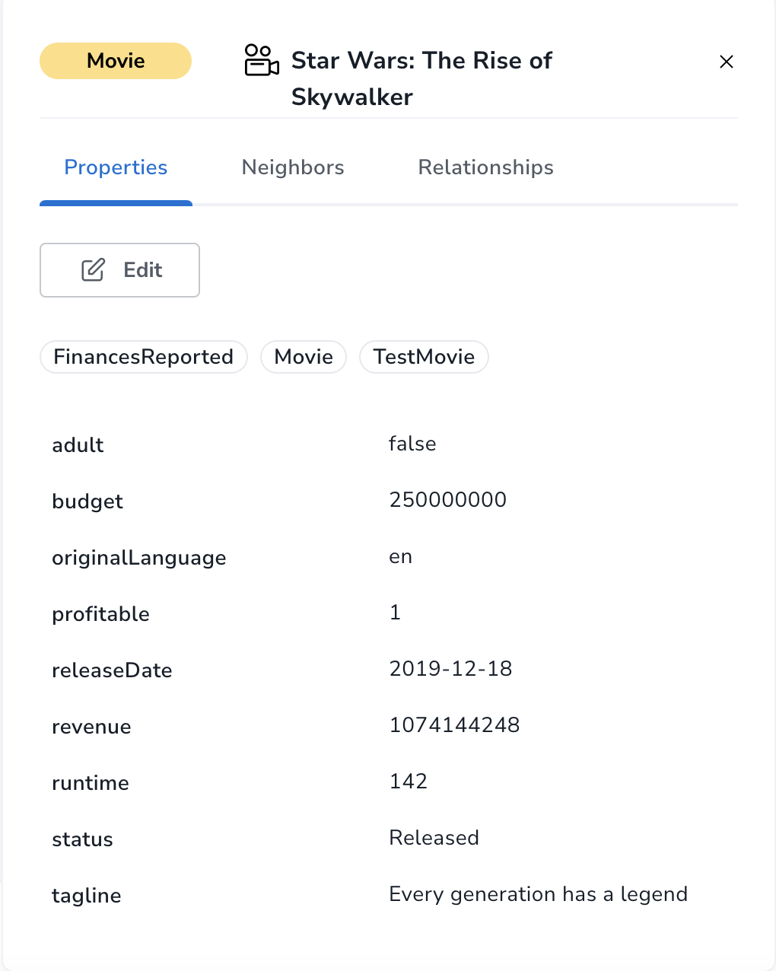
Properties on movie nodes are easy to use
They are already at the right grain to add to a data frame

Slide 8
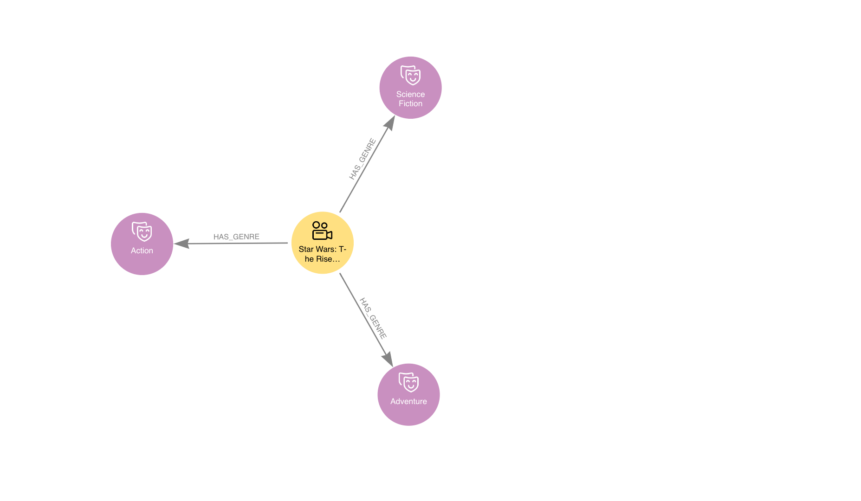
Genres need a little manipulation

Slide 9
Represent them with one-hot encoding
Movie | Action | Adventure | Animation | Comedy | Crime | Documentary | Drama
Star Wars: The Rise of Skywalker | 1 | 1 | 0 | 0 | 0 | 0 | 0

Slide 10
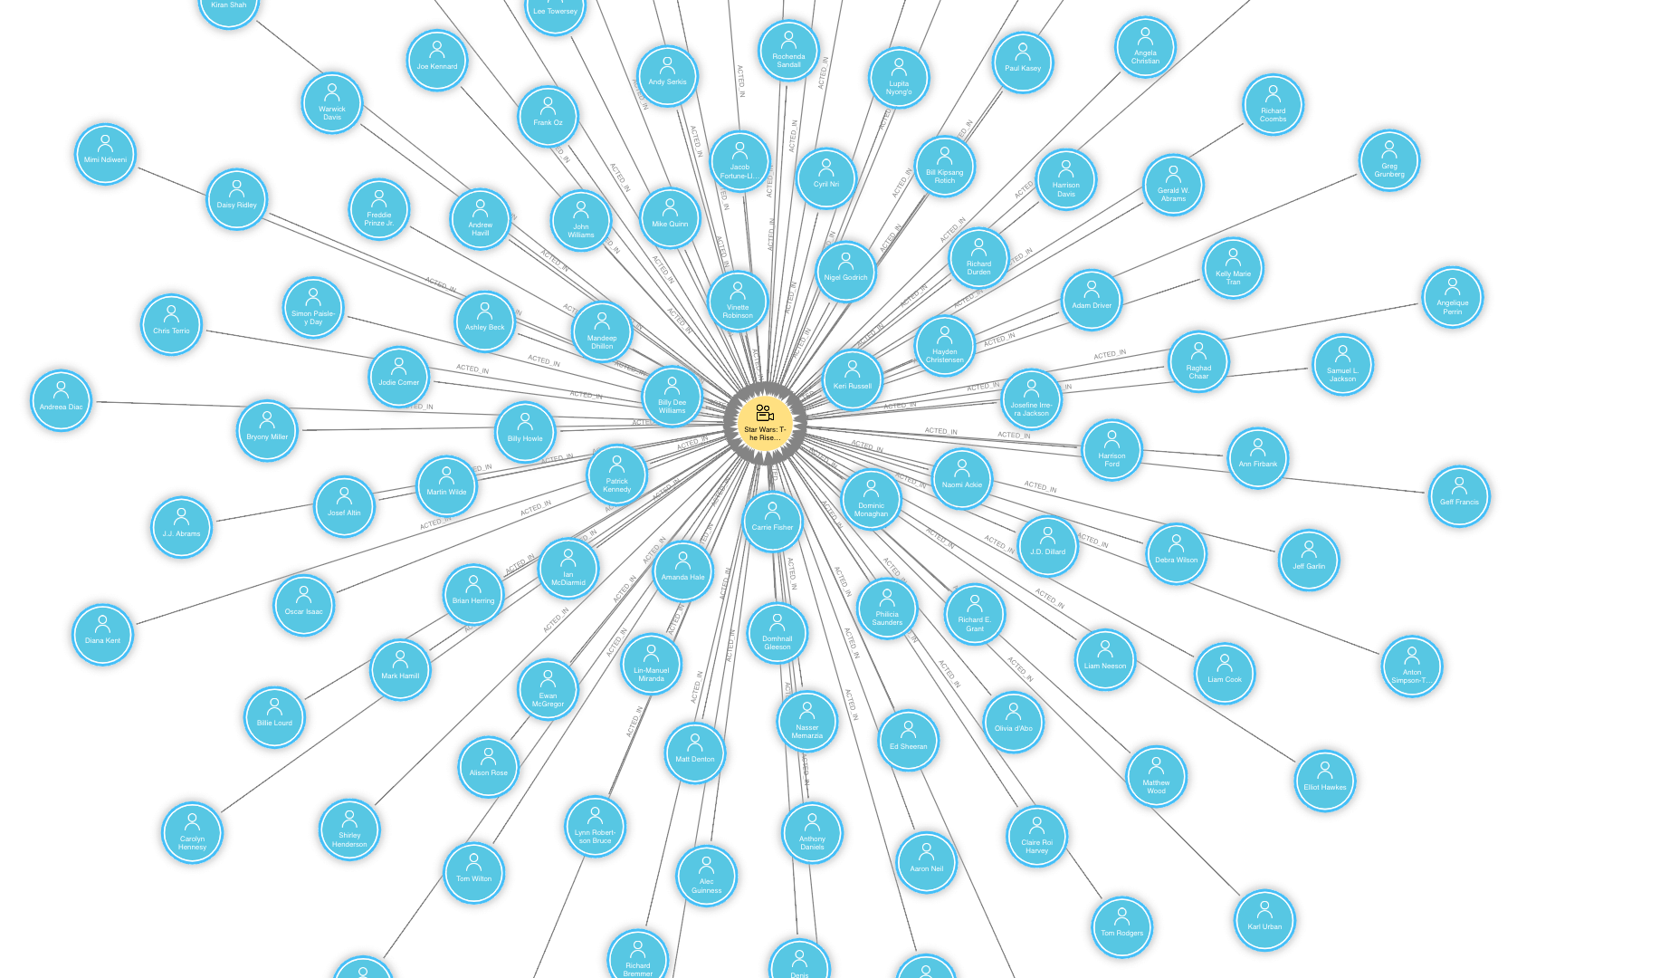
Cast and crew aren’t a good fit for one-hot encoding

Slide 11

Use experience of the star with top billing
How many films had Carrie Fisher appeared in before Star Wars: Rise of Skywalker?

Slide 12
Our final dataframe
Movie | Budget | Star Experience | Action | Adventure | Animation | Comedy |  | Profitable
Star Wars: The Rise of Skywalker | 250,000,000 | 79 | 1 | 1 | 0 | 0 |  | 1
…

Slide 13
Split data
Use films released between 1980 and 2016 as context for the “star experience” feature
Use films released in 2016-2017 as training data
Use films released in 2018 as validation data for tuning hyperparameters
Use films released in 2019 as test data
Deliberately avoided 2020 data because of COVID disruptions to the movie industry

Slide 14
Baseline model results
Used LightGBM (Light Gradient Boosting Machine) library for model
Used Optuna library to tune LightGBM hyperparameters
Results:
Test F1: 0.70
Test AUC: 0.65
Test confusion matrix:
 | Predicted unprofitable | Predicted profitable
True unprofitable | 25 | 23
True profitable | 37 | 70

Slide 15
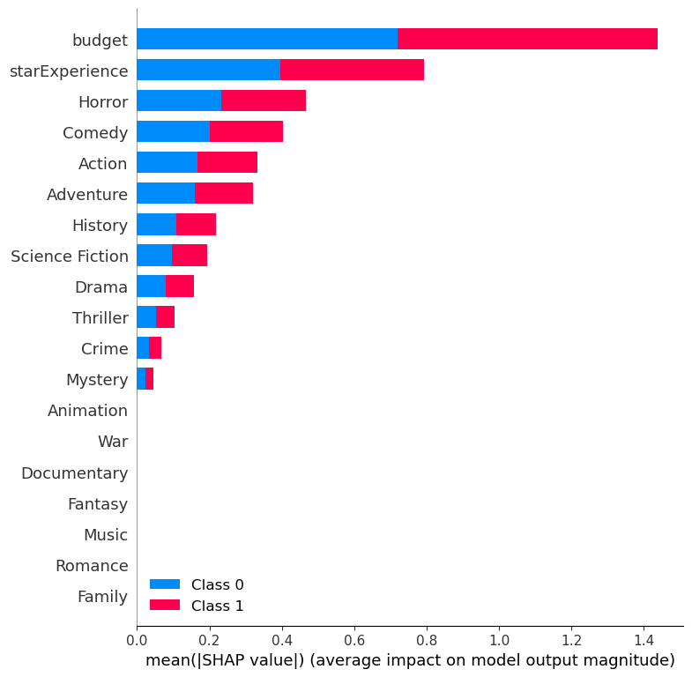
Feature importances

Slide 16
A look at the Python code

Slide 17
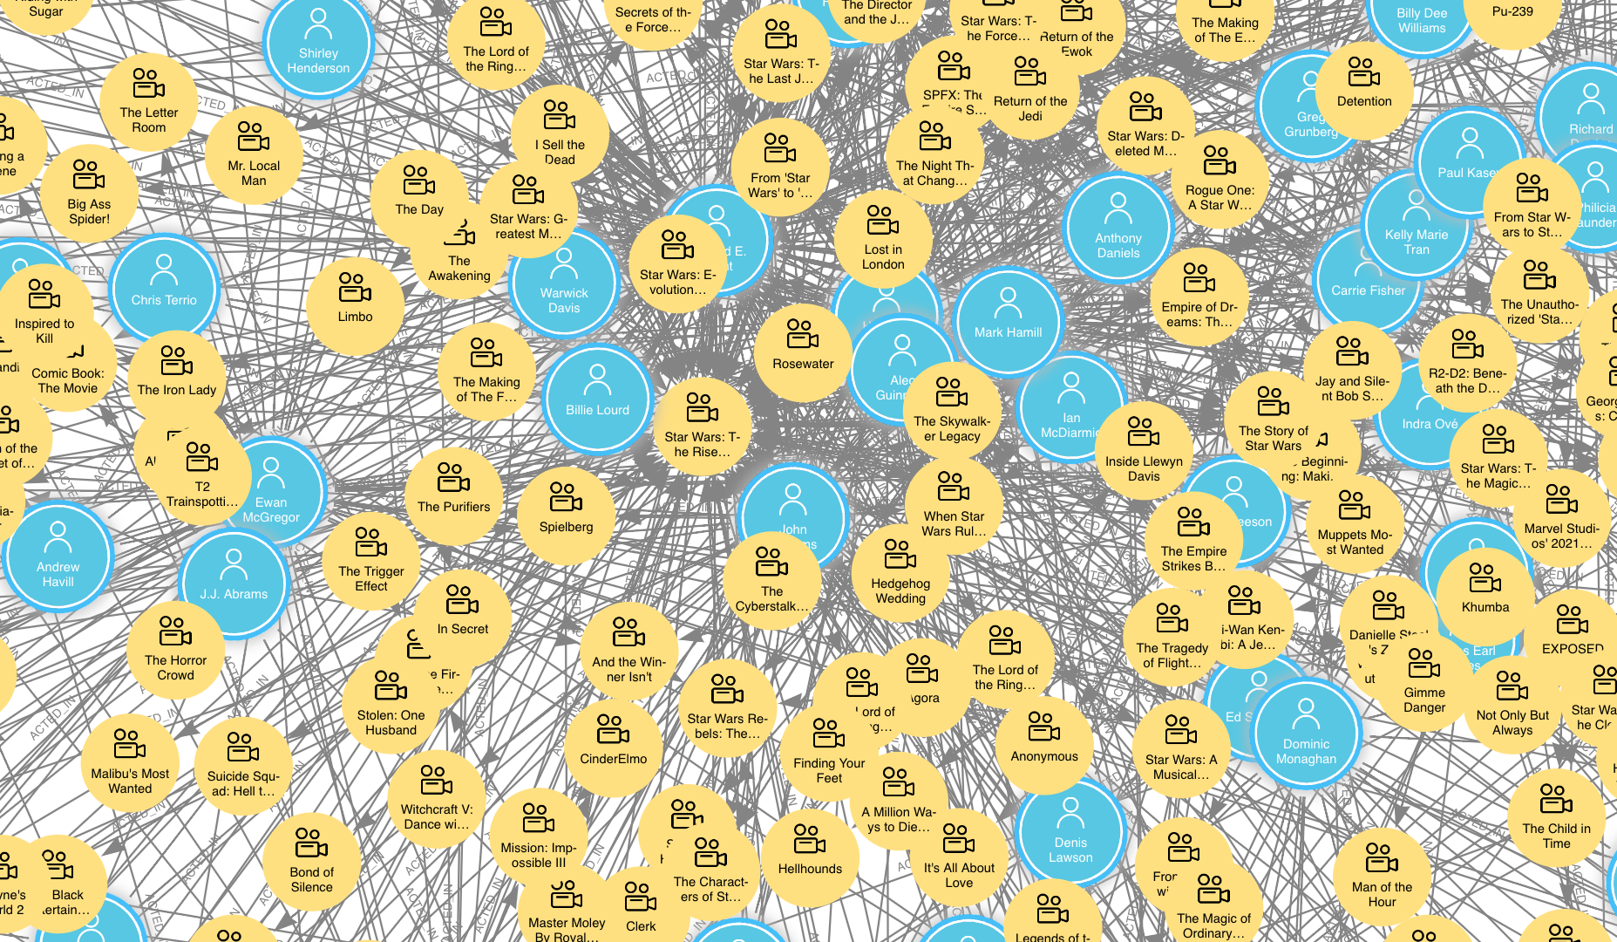
Can we do something more with the cast and crew?

Slide 18
Use Fast RP to represent the cast as a vector
Movie | Embedding
Star Wars: The Rise of Skywalker | [0.0318, 0.4215, -0.2183, 0.7352, … 0.9389]

Slide 19
How does FastRP work?
FastRP stands for Fast Random Projection
Choose an embedding dimension
Assign each node a random position in the vector space
Think of the initial projection like a signature for the node that gets broadcast across the graph
Carrie Fisher
The Rise of Skywalker
Adam Driver
Mark Hamill
Daisy Ridley
The Return of the Jedi

Slide 20
Create a new vector representation of each node
The new vector is located at the average coordinates of each node’s neighboring nodes in the graph
Nodes with common neighbors end up closer together in the new vector space
Carrie Fisher 0
The Rise of Skywalker 0
The Return of the Jedi 1
The Rise of Skywalker 1
Adam Driver 0
Mark Hamill 0
Daisy Ridley 0
The Return of the Jedi 0

Slide 21
Repeat the aggregation process to generate more intermediate representations of each node
Rise of Skywalker 0
random projection
Avg
Carrie 0 Mark 0
Daisy 0
Adam 0
Rise of Skywalker 1
Avg
Carrie 1 Mark 1
Daisy 1
Adam 1
Avg
Rise of Skywalker 2
When Harry Met Sally 0 Drop Dead Fred 0
Rise of Skywalker 0
Return of the Jedi 0
Avg
Avg
Carrie 2 Mark 2
Daisy 2
Adam 2
Avg
Meg Ryan 0 Billy Crystal 0
Carrie Fisher 0
Bruno Kirby 0
Rise of Skywalker 3
When Harry Met Sally 1 Drop Dead Fred 1
Rise of Skywalker 1
Return of the Jedi 1
Notes:
Note that the 0 level vectors switch from person to movie as we go from odd to even iterations. We’ll tend to include at least an odd and an even iteration in our final calculations.

Slide 22
Combine intermediate projections to get a final embedding
Normalize each intermediate vector to preserve direction but make the length 1 (L2 norm).
Multiply each intermediate vector by iteration weights specified by the data scientist.
Sum the weighted intermediate vectors to get the final embedding for the node.

Slide 23
FastRP nuances

Slide 24
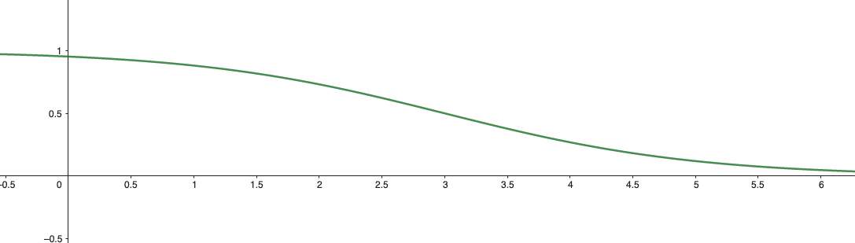
Not all actors are equally influential in the movie’s success
Use a logistic function to taper the effects of the minor characters
Makes aggregation calculation a weighted average of the nodes neighbors
How fast to taper becomes a hyperparameter of the model
Use the tapered value as the relationship weight parameter for FastRP

Slide 25
We can incorporate node properties in the projection
Use node properties to apply a linear transformation to the random projection
Nudges nodes with similar property values in the same direction
Use the property ratio parameter to control the strength of the nudge
We used properties “budget,” “actor experience,” and “profitable” in the final embeddings
< Less experience
More experience >
Carrie Fisher
The Rise of Skywalker
Adam Driver
Mark Hamill
Daisy Ridley
The Return of the Jedi

Slide 26
We can include the node’s initial random projection in the embedding formula
By default, the initial random projection is not included when you sum the intermediate projections to get the embedding
Why would you want to include it?
You might have some nodes with no relationships.
With no self-influence, these nodes would all end up with embedding [0, 0, 0…0]
They would end up in the same place in the embedding space even though they might not really be very similar
You want to give extra emphasis to the node properties that are baked into the initial vector
Use the selfInfluence parameter to determine how much each node’s initial random projection impacts the final embedding

Slide 27
Normalization strength changes the influence of high degree nodes
Node degree tends to be distributed unevenly in graphs
Some nodes will be sending their randomly projected “signature” out across the graph many more times than other nodes
We can use a positive normalization strength to dampen the influence of high degree nodes
In some situations, you might use a negative normalization strength to boost the influence of high degree nodes

Slide 28
Train the embedding-based model

Slide 29
Our embedding data frame
Movie | Budget | Action | Adventure |  | War | Embedding1 | Embedding2 |  | Profitable
Star Wars: The Rise of Skywalker | 250,000,000 | 1 | 1 |  | 0 | 0.938 | -0.213 |  | 1
…
…

Slide 30
Split data
Use the same train-validation-test cut dates as the baseline model
Make sure that test movies are excluded from the graph projection when calculating embeddings for training, otherwise you will get data leakage
Only use profitability values from previous periods when generating embeddings
Train embeddings can see profitability for context movies only
Validation embeddings can see profitability for context and train movies
Test embeddings can see profitability for contest, train, and validation movies
Impute 0.5 for movies in the period you are making predictions for

Slide 31

Use Optuna to control LGB and FastRP parameters
Rather than using one train and one validation set, we will generate new train and validation sets with different embedding parameters for each model run
Dramatically increased hyperparameter search space requires more trials to explore
It’s easier for Optuna to get stuck in a local minimum, so you might try different initial parameter values

Slide 32
The results!
Baseline model
Test F1: 0.70
Test AUC: 0.65
Confusion matrix:
Embedding model
Test F1: 0.81
Test AUC: 0.73
Confusion matrix:
 | Pred - | Pred +
True - | 25 | 23
True + | 37 | 70
 | Pred - | Pred +
True - | 23 | 25
True + | 18 | 89

Slide 33
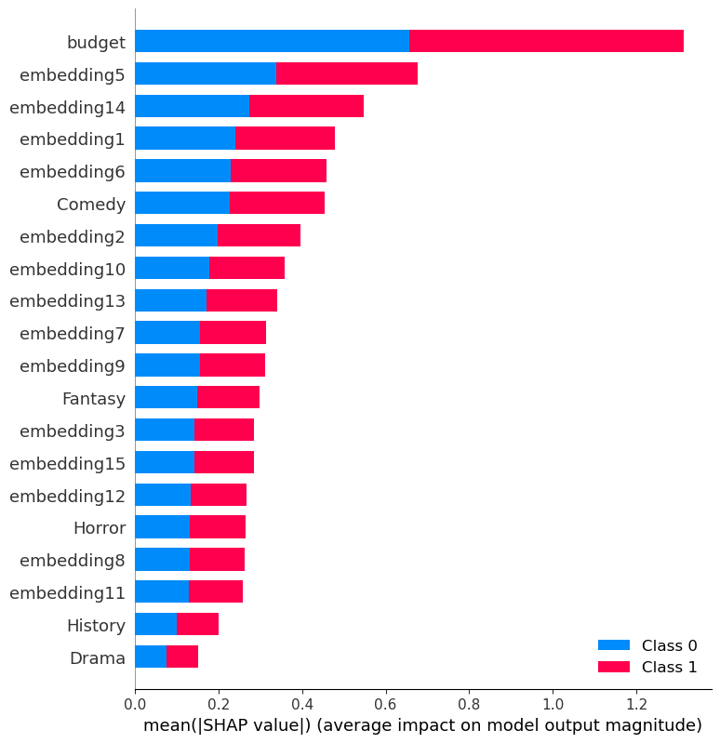
Feature importances

Slide 34
A look at the Python code

Slide 35
The takeaway
Graph embedding allowed us to represent the complex network of actor-movie relationships as a vector that could be consumed by a popular machine learning algorithm, LightGBM.
There are many ways to tune the graph embeddings to get the best performance.
Adding the embeddings to our model features led to a 15% increase in F1 score over the baseline model.

Slide 36
Thank you!
nathan.smith@neo4j.com
@nsmith_piano
https://www.linkedin.com/in/nathansmithit/

